Slide 1

Multi-threading in your PowerShell scripts
…using Runspaces - a ‘real world’ use case
@n_boulton
@PSSouthampton

Slide 2
USE CASE
We implemented a Nutanix Hyper-Converged Infrastructure (HCI) in 2018
Heavily network-dependent
A solution that could monitor key components of this was required – a PowerShell script of course!

Slide 3
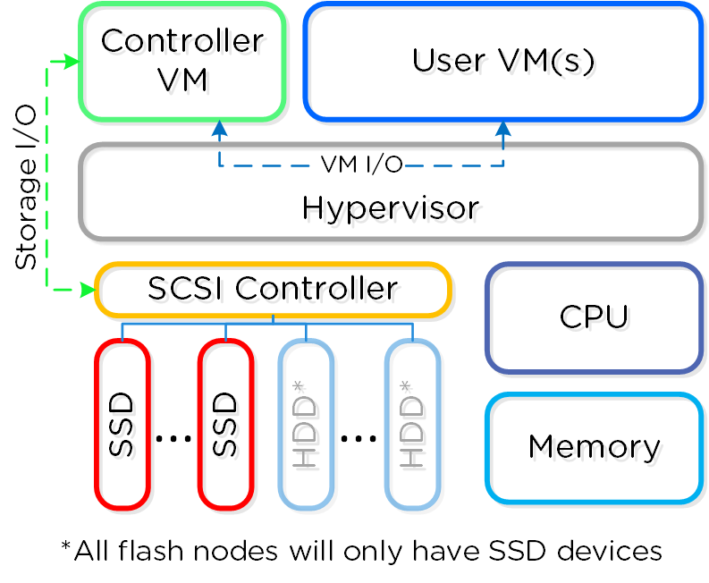
ANATOMY OF A NUTANIX NODE

Slide 4
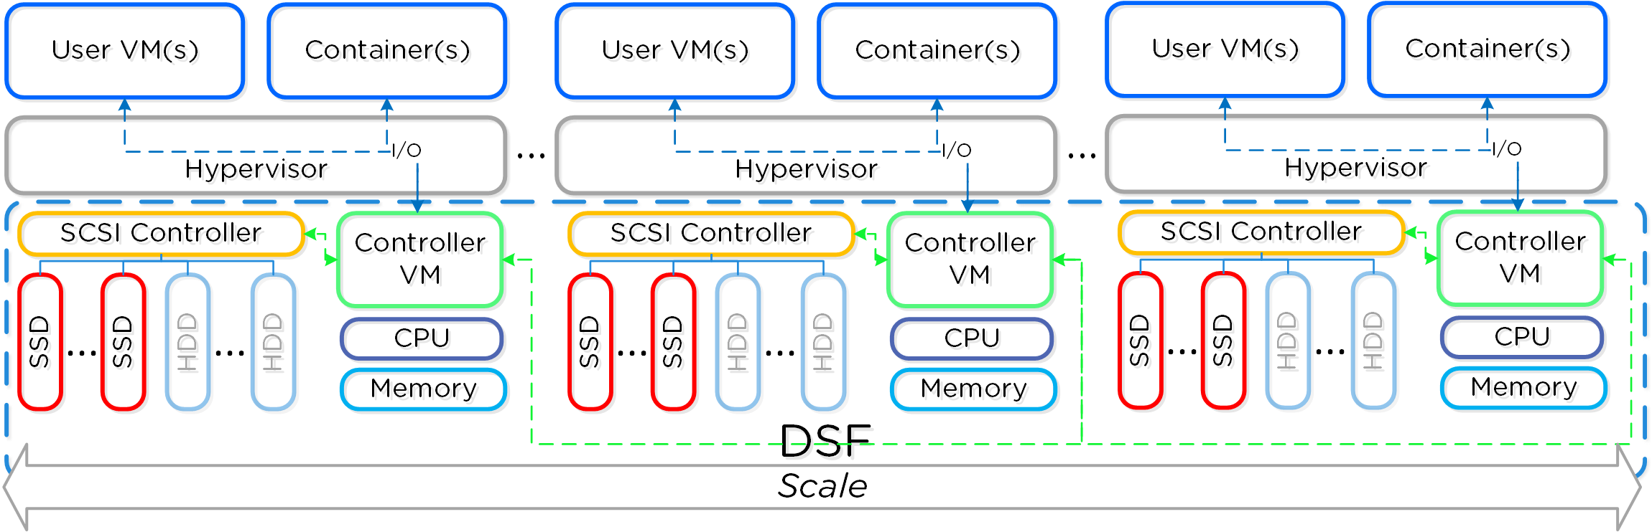
Distributed system
2 IP addresses with 4 ports each
2 IP addresses with 4 ports each
2 IP addresses with 4 ports each
2 IP addresses with 5 ports each
2 IP addresses with 5 ports each
2 IP addresses with 5 ports each

Slide 5
REQUIREMENTS
Monitor connectivity to every CVM and hypervisor IP address, and record latency to each
Monitor for ports that stop listening (=failed services)
Record the results in a format that can be easily analysed
Do this as frequently as possible to avoid missing anything!
Scope for alerting to be added later if required

Slide 6
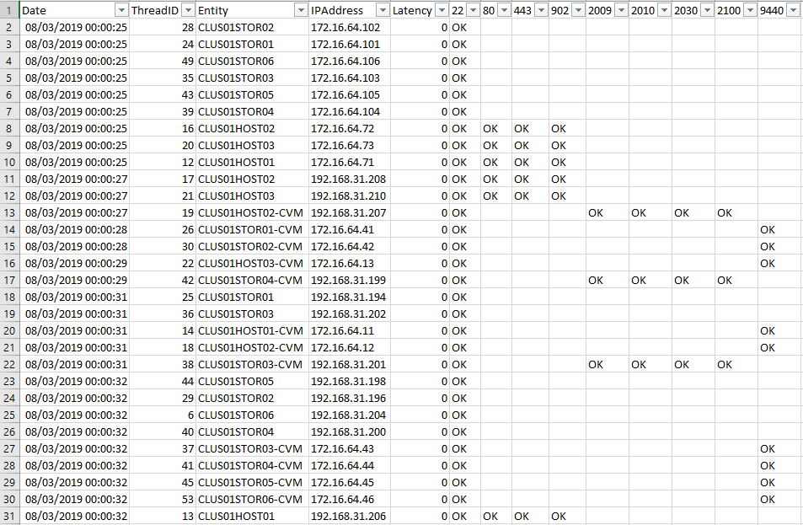
SAMPLE OUTPUT

Slide 7
DEMO - PROOF OF CONCEPT SCRIPT
Simplified script showing key concepts, suitable for sharing
Simplified config file
Demo setup:
Demo endpoint is a Hyper-V VM with 10 IP addresses, representing 5 hosts
Monitoring some common listening Windows ports (3389, 445)
Jobs will not be restarted after running for 1 minute

Slide 8
resources
Most helpful blog post:
https://devblogs.microsoft.com/scripting/beginning-use-of-powershell-runspaces-part-1/
Microsoft Docs:
https://docs.microsoft.com/en-us/dotnet/api/system.management.automation.powershell?view=powershellsdk-1.1.0
Boe Prox’s PoshRSJob Module:
‘Install-Module –Name PoshRSJob’ or https://github.com/proxb/PoshRSJob
https://devblogs.microsoft.com/scripting/weekend-scripter-a-look-at-the-poshrsjob-module/
Using Mutex’s:
https://learn-powershell.net/2014/09/30/using-mutexes-to-write-data-to-the-same-logfile-across-processes-with-powershell/

Slide 9
THANK YOU

